Slide 1
Boolean Equation
AB+A(B+C)+B(B+C)

Slide 2
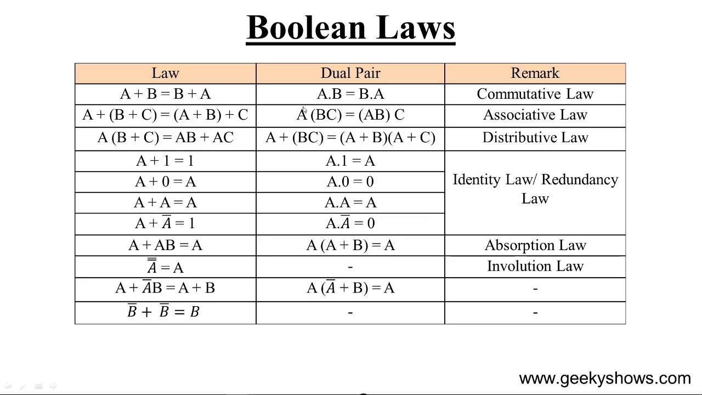
Simplification Using Boolean Algebra

Slide 3
AB+A(B+C)+B(B+C)
(Apply distributive law)
AB+AB+AC+BB+BC
(apply rule BB=B)
AB+AB+AC+B+BC
(apply AB+AB=AB)
AB+AC+B+BC
(apply 10; B+BC=B) absorption law
AB+AC+B
(apply 10; AB+B=B)
B+AC

Slide 4
Try Simplify these:

Slide 5
Standard Forms of Boolean Expressions
All Boolean expressions, regardless of their form, can be converted into either of two standard forms:
■ The sum-of-products (SOP) form
The product-of-sums (POS) form
Standardization makes the evaluation, simplification, and implementation of Boolean expressions much more systematic and easier.

Slide 6
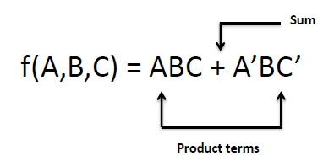
Sum of Product
The sum-of-products (SOP) form is a method(or form) of simplifying the Boolean expressions of logic gates.
Sum and product derived from the symbolic
representations of the OR and AND functions.
OR (+) , AND ( . ) , addition and multiplication.

Slide 7
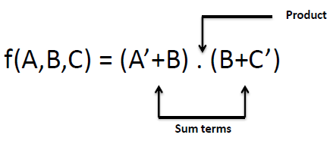
Product of Sum
When two or more sum terms are multiplied by a Boolean OR operation.
Sum terms are defined by using OR operation
and the product term is defined by using AND
operation.

Slide 8
Standard SOP and POS Forms
The canonical forms are the special cases of
SOP and POS forms.
These are also known as standard SOP and
POS forms.

Slide 9
Canonical Form
In SOP or POS form, all individual terms do not
involve all literals.
For example
AB + A’BC the first product term,do not contain literal C.
If each term in SOP or POS contain all literals
then the expression is known as standard or
canonical form.

Slide 10
Canonical Form
Each individual term in the POS form is called Maxterm.
Each individual term in the SOP form is called Minterm.
In Minterm, we look for the functions where the output
results is “1”.
while in Maxterm we look for function where the output
results is “0”.
We perform Sum of minterm also known as Sum of products (SOP) .
We perform Product of Maxterm also known as Product of
sum (POS).

Slide 11
Minterm and Maxterm

Slide 12
convenient to express the boolean function when it is in sum of minterms
F(X,Y,Z)=Σ(1,4,5,6,7)
So, F(X,Y,Z)=Σ(1,4,5,6,7) = X’Y’Z+XY’Z’+XY’Z+XYZ’+XYZ

Slide 13
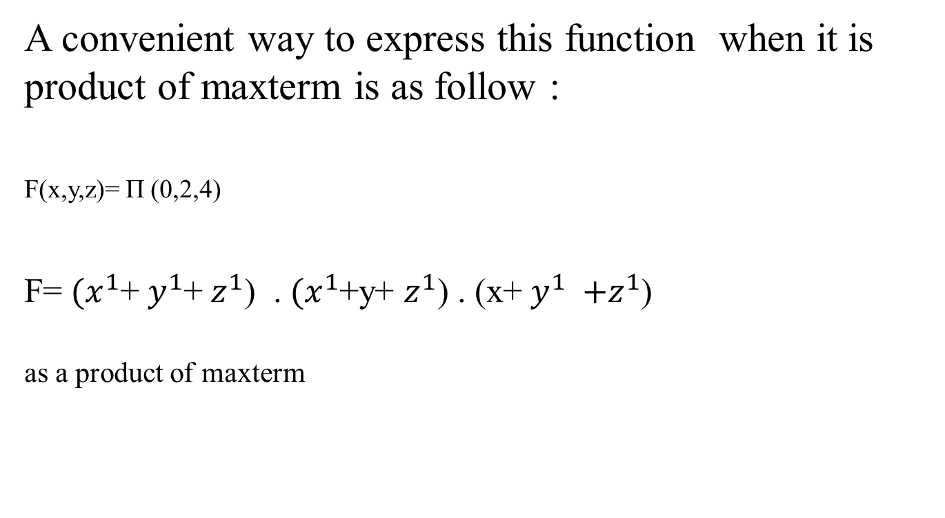
A convenient way to express this function when it is product of maxterm is as follow :
F(x,y,z)= Π (0,2,4)
F= ${(x}^{1}$+ $y^{1}$+ $z^{1}$) . ${(x}^{1}$+y+ $z^{1}$) . (x+ $y^{1} {+z}^{1}$)
as a product of maxterm

Slide 14
Convert SOP to standard SOP form
Step 1: Find the missing literal in each product
term if any.
Step 2: And each product term having missing
literals with terms form by ORing the literal and
its complement.
Step 3: Expends the term by applying,distributive law and reorder the literals.
Step 4: Reduce the repeated product terms.
Because A + A = A (Theorem 1a ).

Slide 15
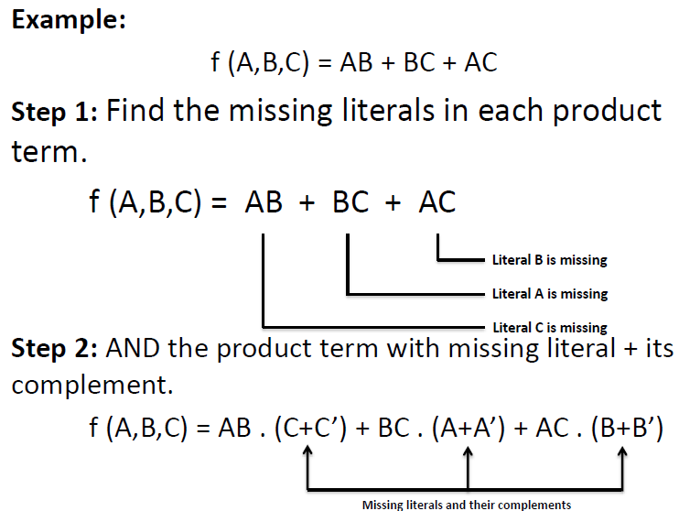
Convert SOP to standard SOP form

Slide 16
Step 3: Expends the term and reorder the literals.
f (A,B,C) = AB . (C+C’) + BC . (A+A’) + AC . (B+B’)
Expand & Reorder:
ABC + ABC’ + ABC + A’BC + ABC + AB’C
Step 4: Omit repeated product terms.
f(A,B,C)=ABC + ABC’ + ABC + A’BC + ABC + AB’C
f(A,B,C)= ABC + ABC’ + A’BC + AB’C

Slide 17
Convert POS to standard POS form
Step 1: Find the missing literal in each sum term
if any.
Step 2: OR each sum term having missing literals
with terms form by ANDing the literal and its
complement.
Step 3: Expands the term by applying distributive law and reorder the literals.
Step 4: Reduce the repeated product terms.
Because A + A = A (Theorem 1a ).

Slide 18
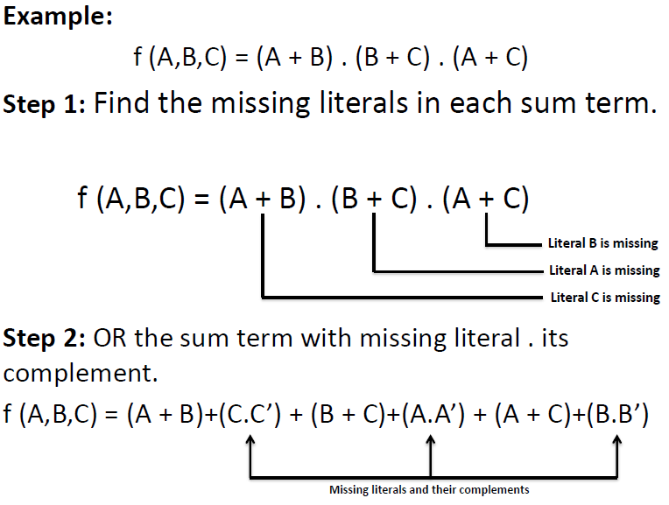
Convert POS to standard POS form

Slide 19
Step 3: Expands the term and reorder the literals.
f (A,B,C) = (A + B)+(C.C’) .(B + C)+(A.A’) .(A +C)+(B.B’)
Expand & Reorder:
f(A,B,C)=(A+B+C).(A+B+C’).(A+B+C).(A’+B+C).(A+B+C).(A+B’+C)
Step 4: Omit repeated sum terms.
f(A,B,C)=(A+B+C).(A+B+C’).(A+B+C).(A’+B+C).(A+B+C).(A+B’+C)
f(A,B,C)=(A+B+C).(A+B+C’).(A’+B+C).(A+B’+C)

Slide 20

Convert the following Boolean expression into standard POS form:

Slide 22
Describing existing circuits using Logic expressions
X1X2′X3+X1′X2′X2+X1′X2X′3
The equation is in sum of product. The implementation is in 2-Levels. AND gates form the first level and a single OR gate the second level.

Slide 23
Exercise
(X+1)(Y+0Z)

Slide 24
(X+1)(Y+0Z)
The equation is neither in sum of product nor in product of sum. The implementation is as follow

Slide 25
Converting SOP Expressions to Truth Table Format (example)

Slide 26
Converting POS Expressions to Truth Table Format (example)

